Slide 1
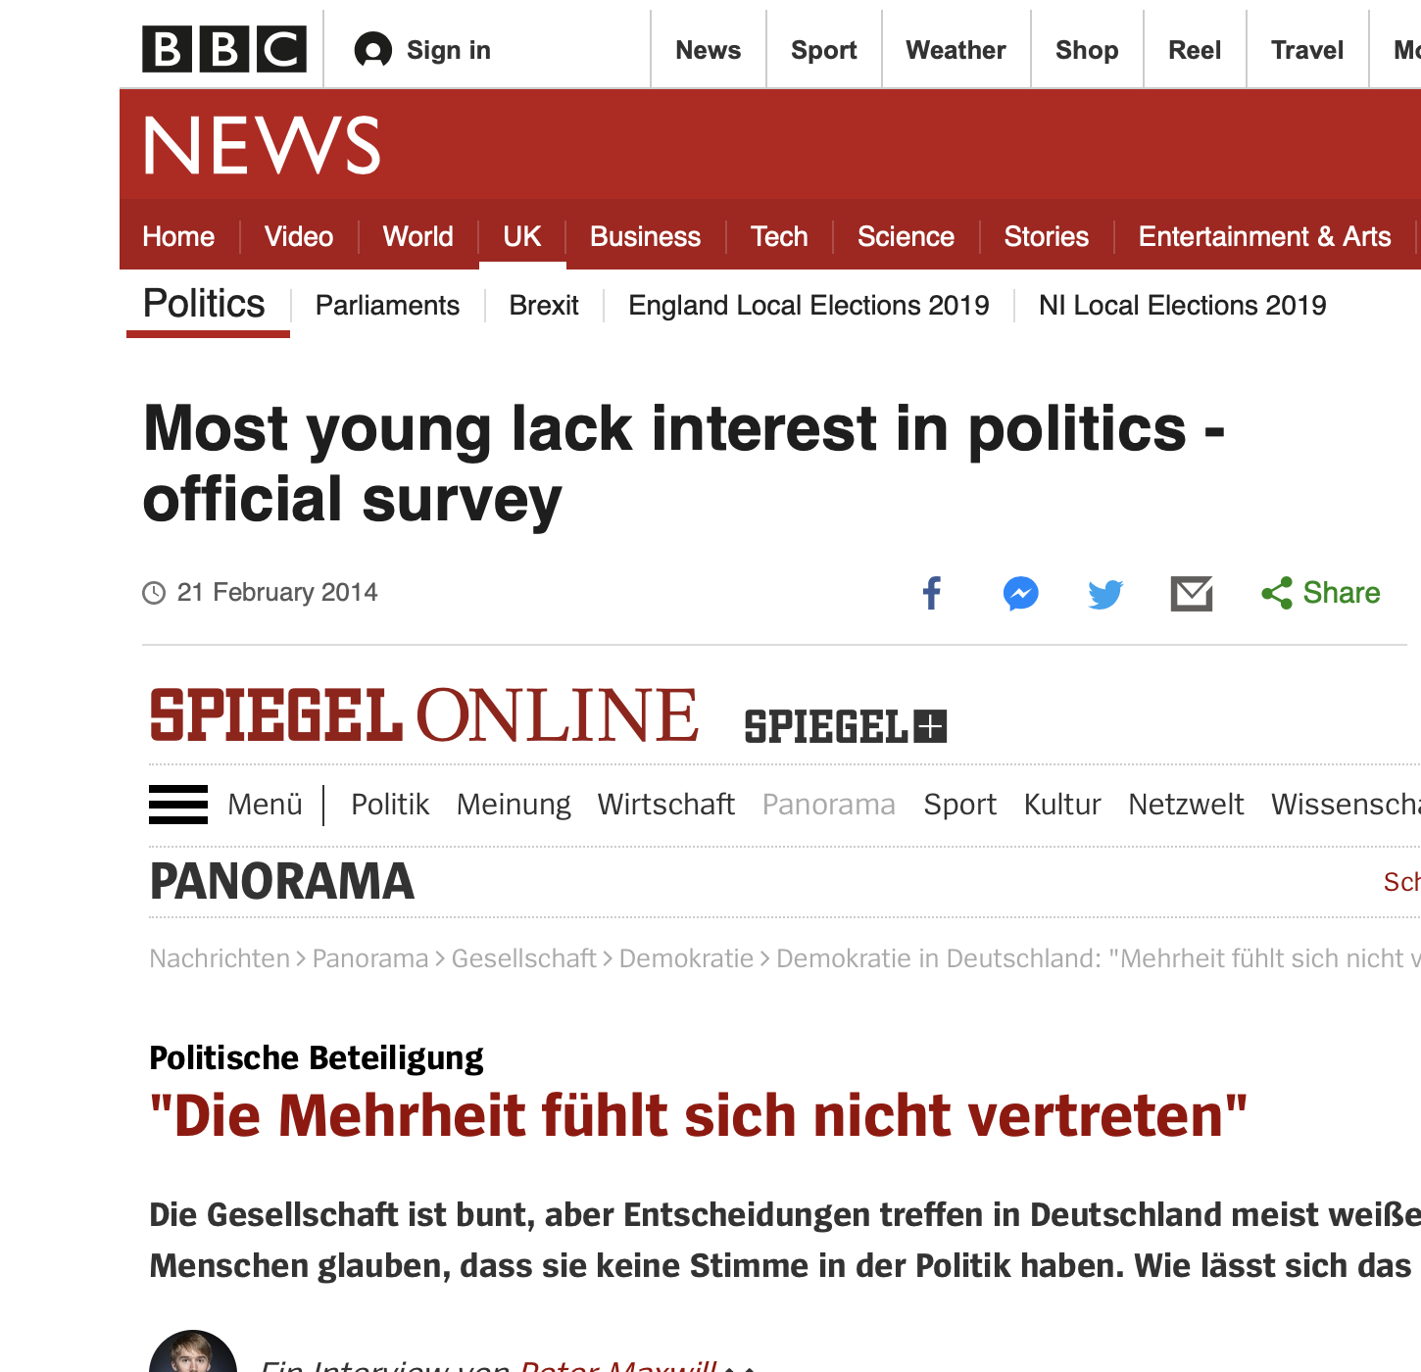
Want big impact?
Use big image.

Slide 2
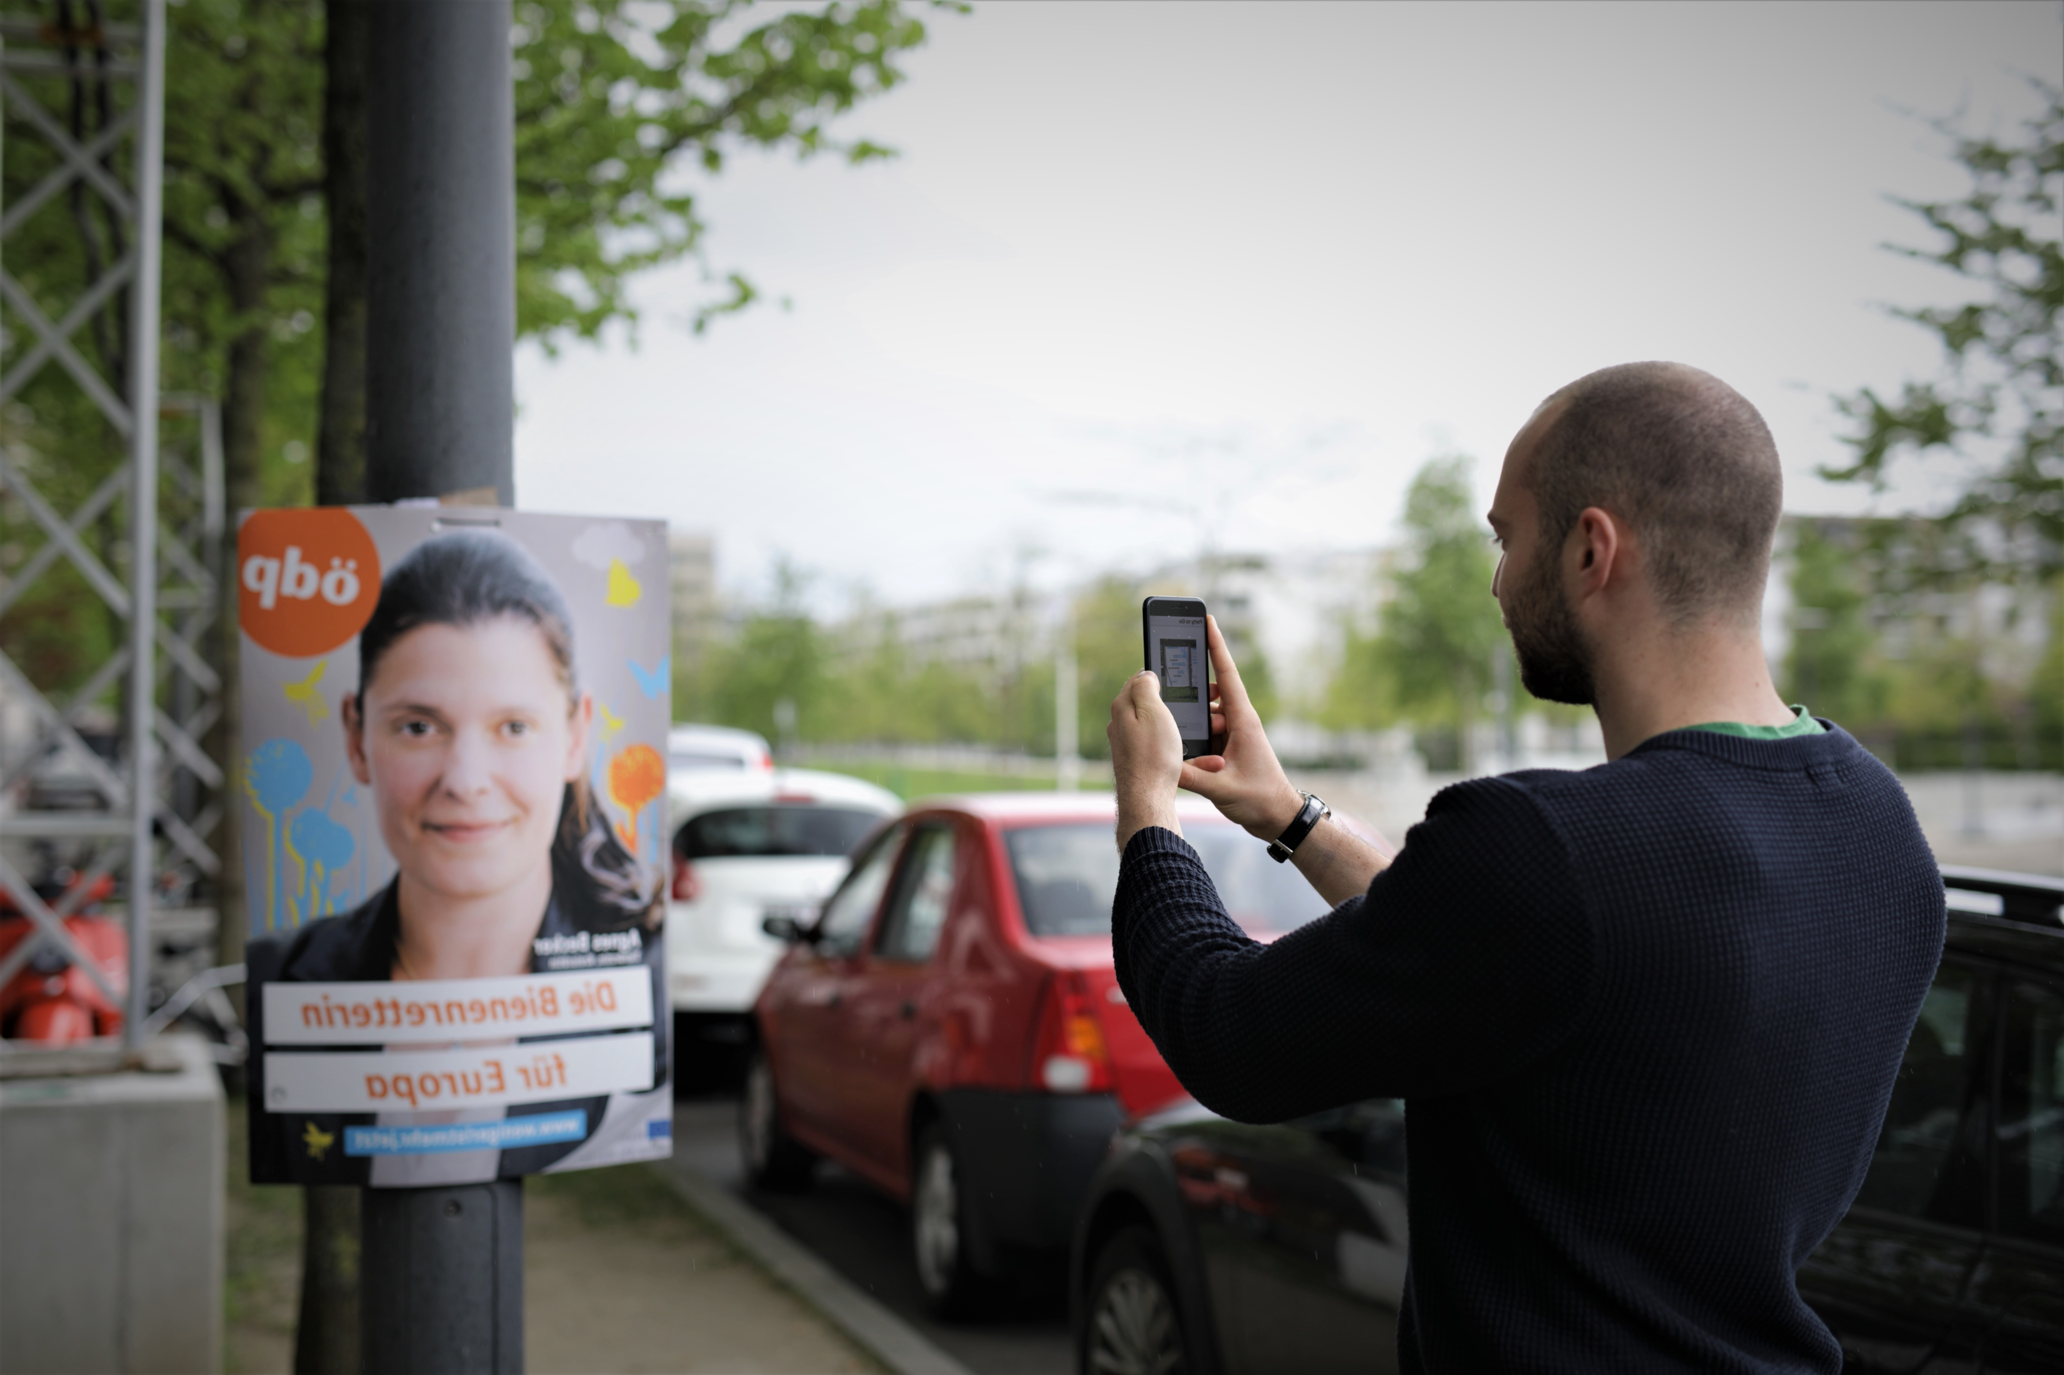
GoDemocracy
Diffie-Hell-Yeah-Man

Slide 3
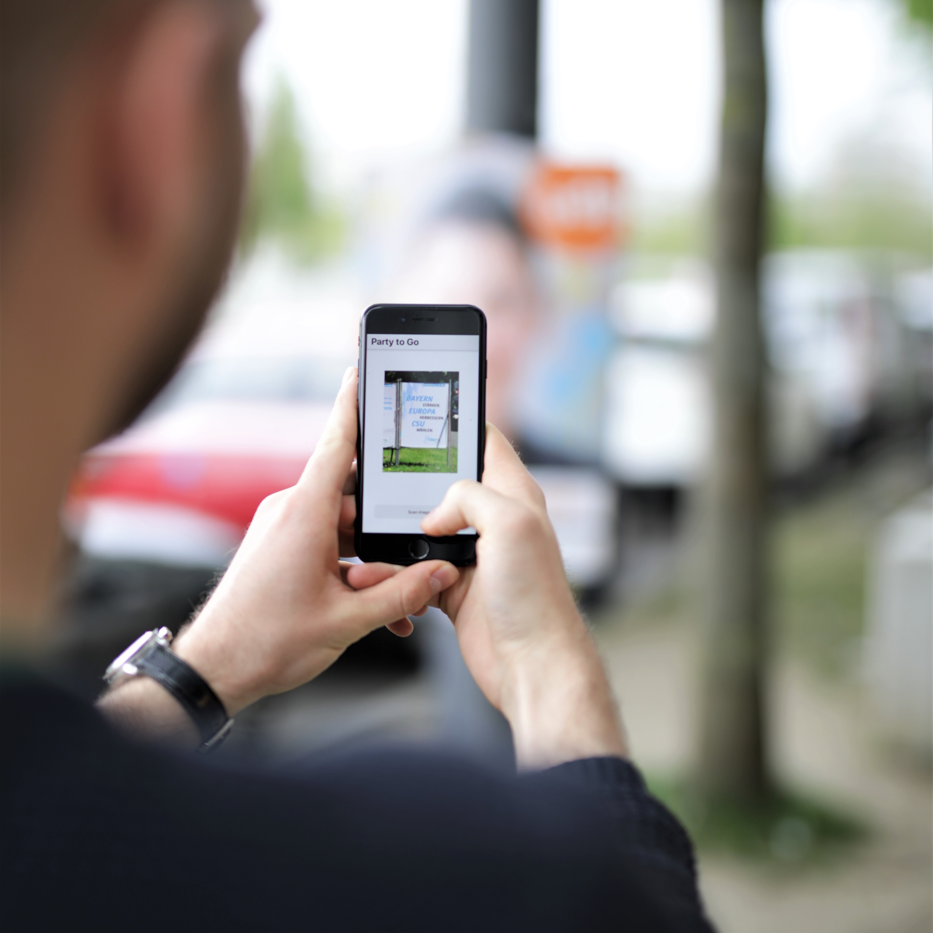
Solution
Scan election poster
Get relevant content
Vote better

Slide 4
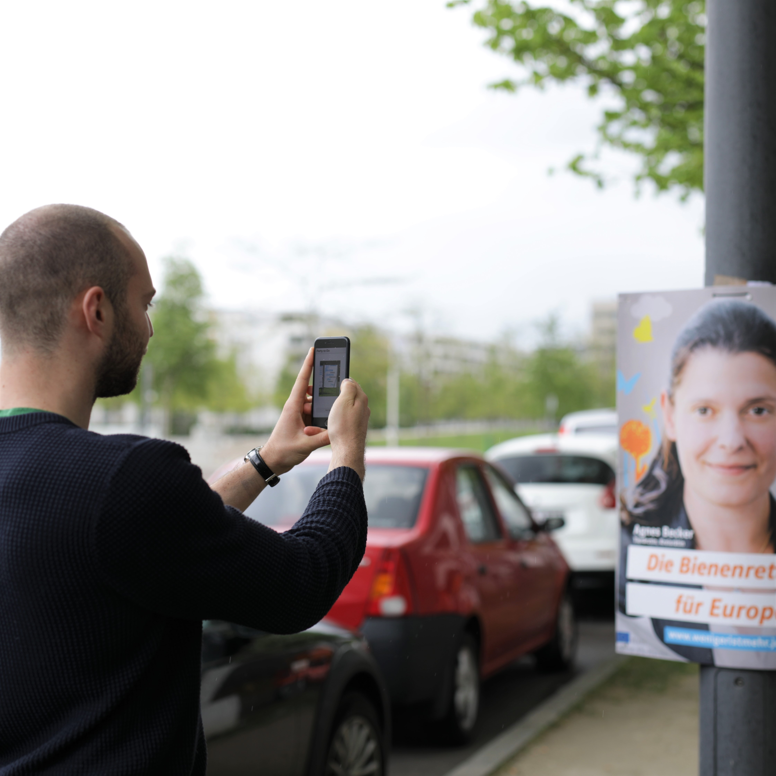
Want big impact?
Use big image.

Slide 5
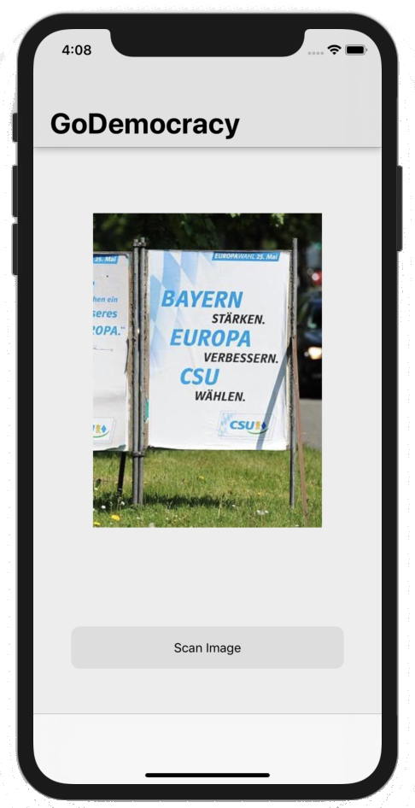
1. Scan
Place your screenshot here

Slide 6
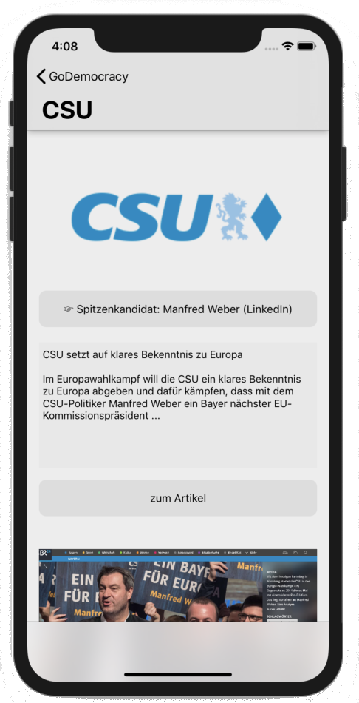
2. Info

Slide 7
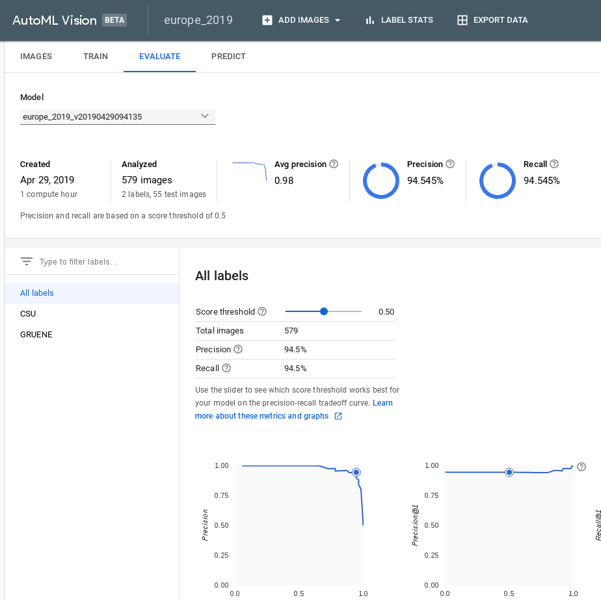
Want big impact?
Use big image.

Slide 8
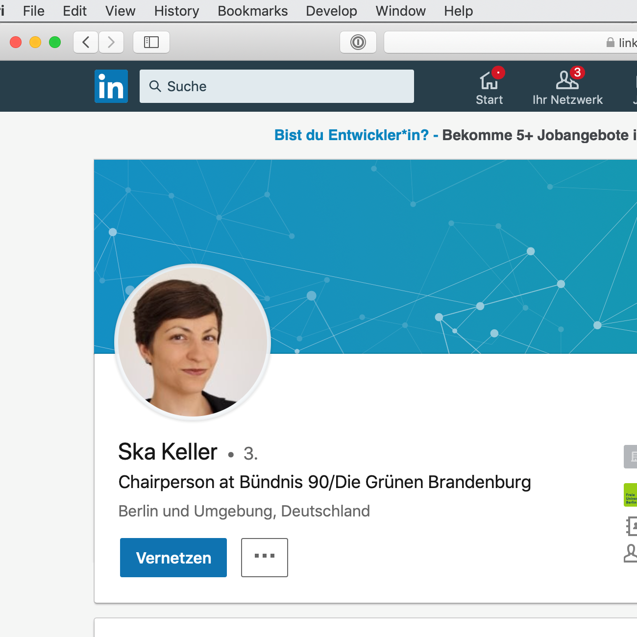
Want big impact?
Use big image.

Slide 9
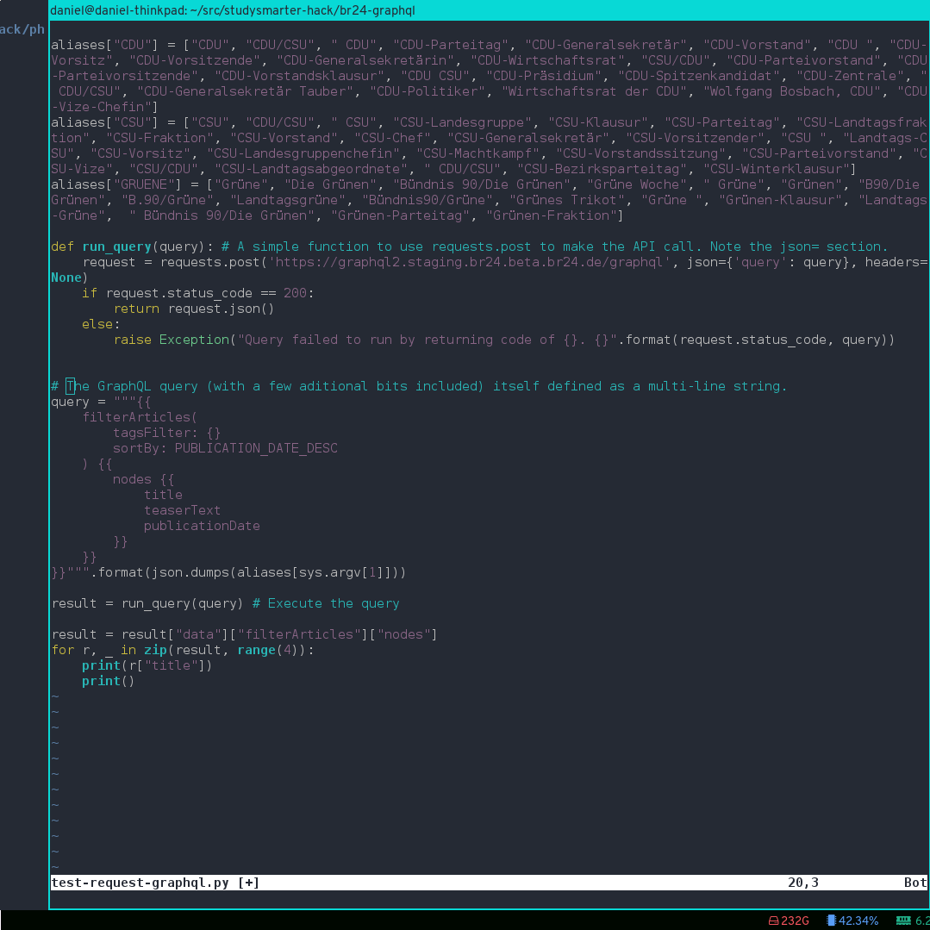
Want big impact?
Use big image.

Slide 10
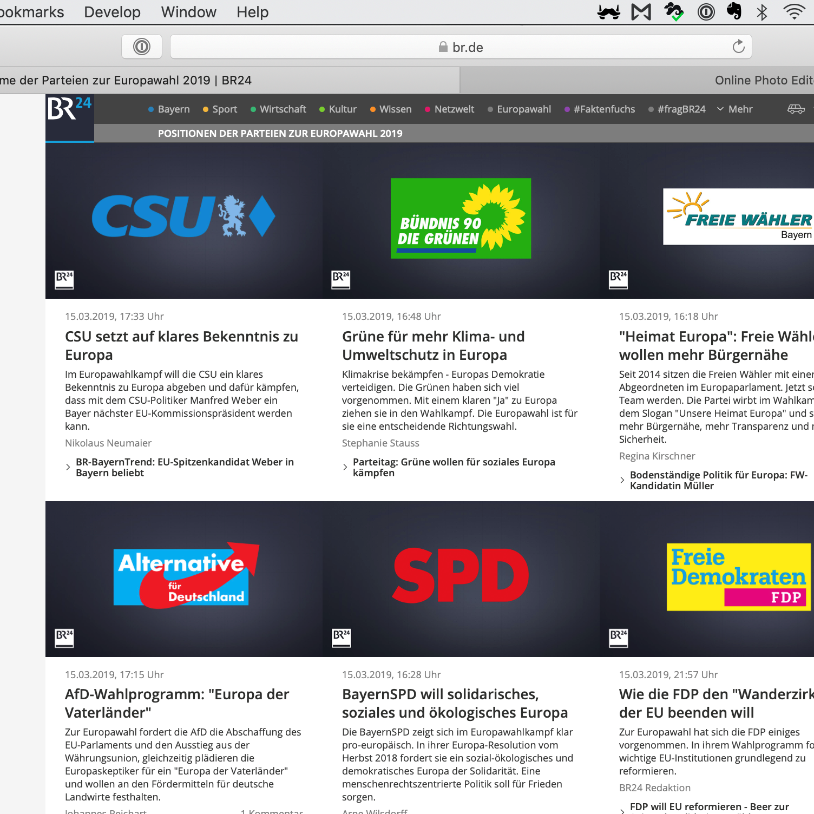
Want big impact?
Use big image.

Slide 11
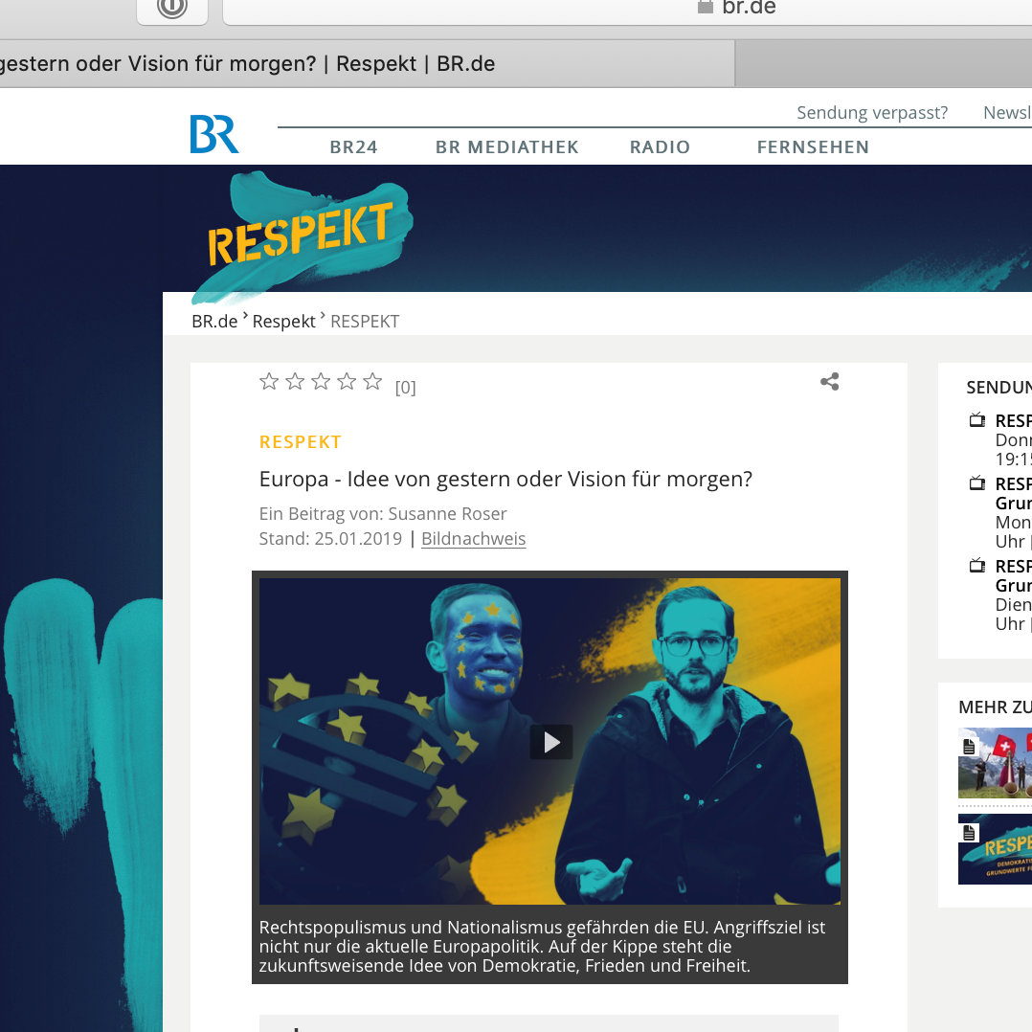
Want big impact?
Use big image.

Slide 12
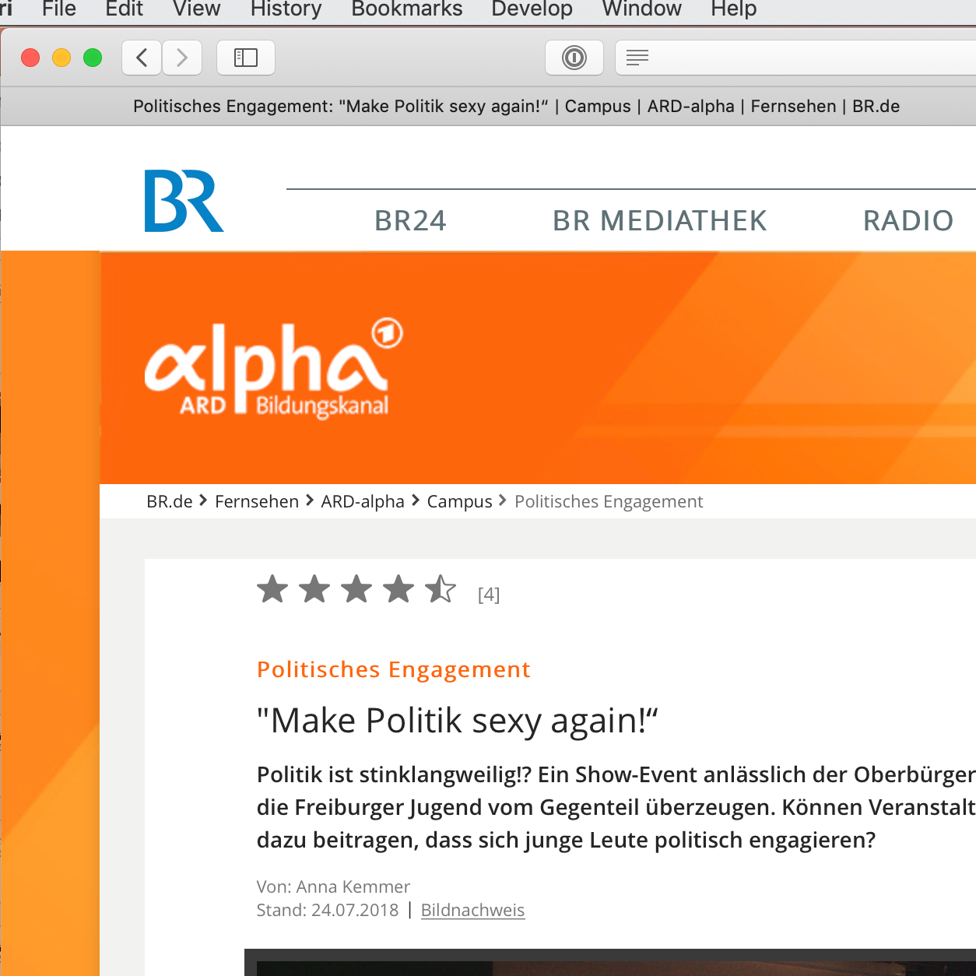
Want big impact?
Use big image.

Slide 13
Thanks! Any questions?
Diffie-Hell-Yeah-Man

